Slide 1
Sentiment Analysis of Demonetisation
Done by Analysis tweets from Twitter regarding Demonetisation
Made by : SHREYAS MISHRA

Slide 2
Demonetisation
On 8th November 2016, at 8 PM IST, the Indian Prime Minister Narendra Modi announced that use of all ₹500 and ₹1000 banknotes of the Mahatma Gandhi Series would be rendered invalid after midnight.
He also announced that new ₹500 and ₹2000 banknotes of the Mahatma Gandhi Series would be issued in a few days.
About 99% of all the notes in circulation had been deposited amounting to about ₹15.28 trillion against ₹15.44 trillion in circulation before demonetisation.

Slide 3
Sentiment Analysis
I have made this sentiment analysis project by extracting tweets from Twitter regarding demonetisation.
There are various hashtags used by people while tweeting regarding this topic by using different spellings, such as #Demonetisation, #DeMonetisation, as well as simple demonetisation word search by using Twitter’s Search API with Python.
These tweets were extracted to a CSV file and I used the AFINN library of Python to perform sentiment analysis. The words of the tweets carry certain points between negative 5 and positive 5 depending upon the word.
The number of positive and negative tweets were counted and a graph was plotted in Python showing the results.

Slide 4
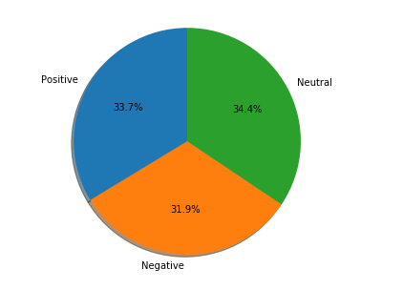
This is a Pie Chart made in Python using Matplotlib module which shows the percentage of people having Positive Negative and Neutral Sentiments.

Slide 5
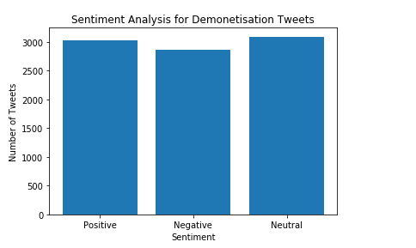
This is a Bar Graph gives information about the number of people having positive, negative and neutral feelings regarding Demonetisation.

Slide 6
Discussion
The free version of Twitter Search API only lets us search tweets posted in the last few days.
I searched various keywords in my program and merged all of the results into one CSV file. After removing the duplicate tweets, I was left with about 9000 tweets on which I performed my analysis.
I also acquired another dataset from GitHub which had tweets posted last year. I also performed by analysis on those tweets. The results were very similar.

Slide 7
Conclusion
We saw in the above Pie Chart and Bar Graph that the sentiment regarding Demonetisation is positive but the number of people who have positive feelings is more than the number of people who have negative feelings by a small amount.
The other dataset which I had acquired from GitHub also gave me similar results.
So in Conclusion I can say that the sentiment towards Demonetisation has been more positive than negative.

